Slide 1
Week8 Activities
Attacks
Tevin Herath

Slide 2
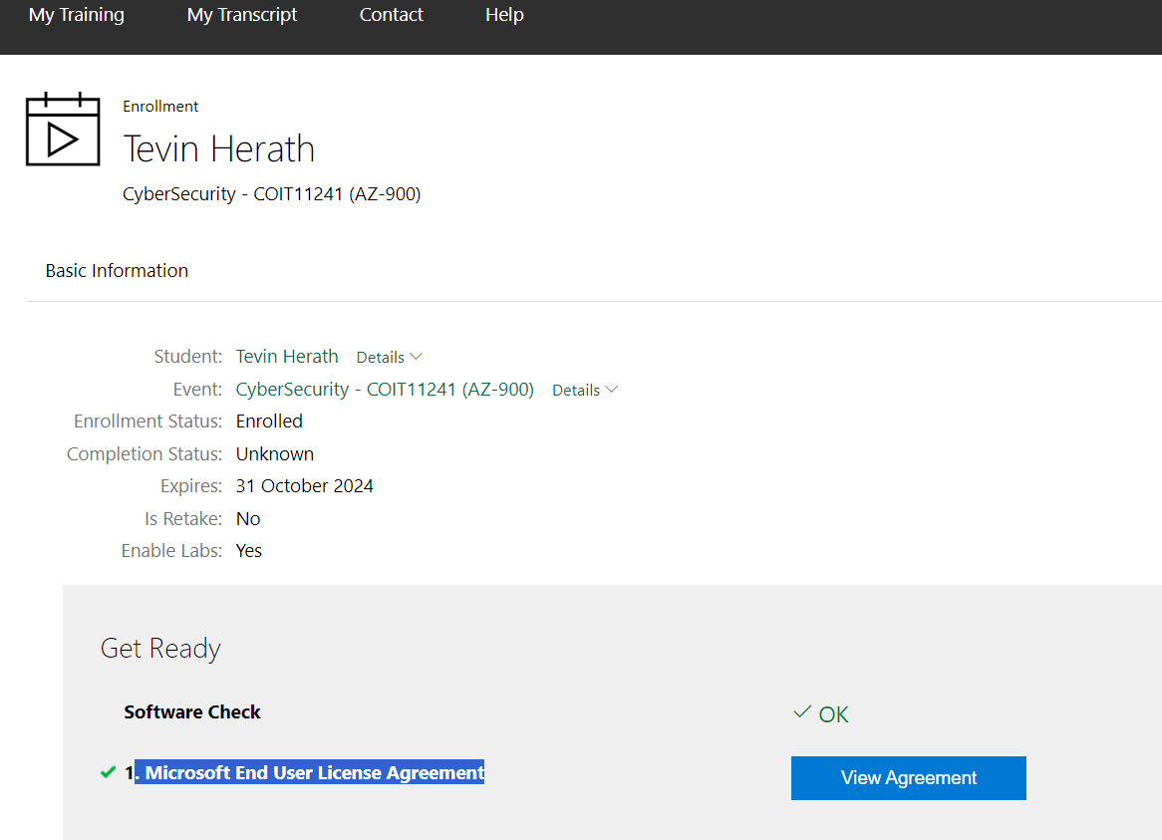
Registered a Microsoft Learn On Demand account with Skillable

Slide 3
Completion of Week8 Handouts
Completed the weekly handouts to gain understanding of different types of cyber attacks and be able to identify them.

Slide 4
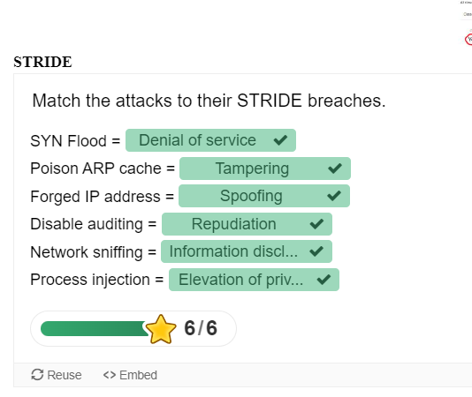
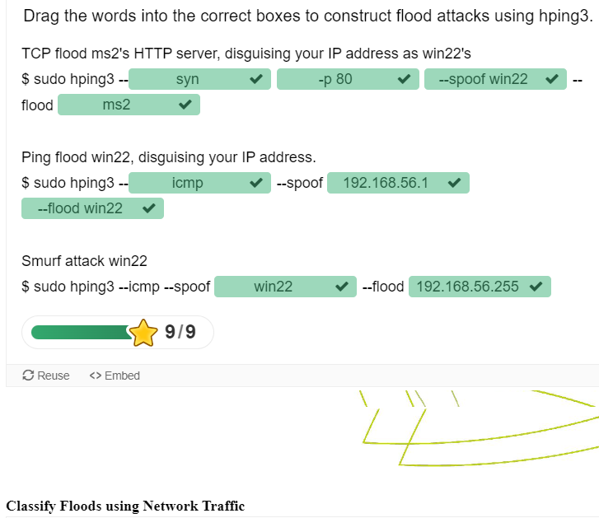
Week8 Handouts (cont.)

Slide 5
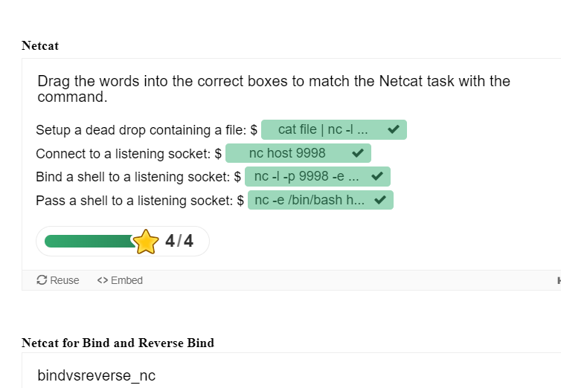
Week8 Handouts (cont.)

